Slide 1
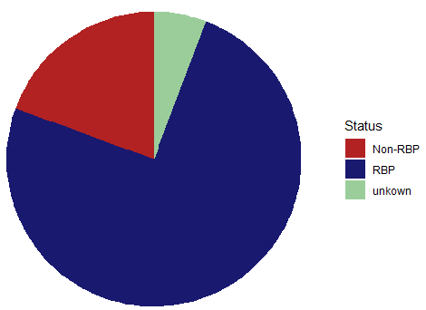
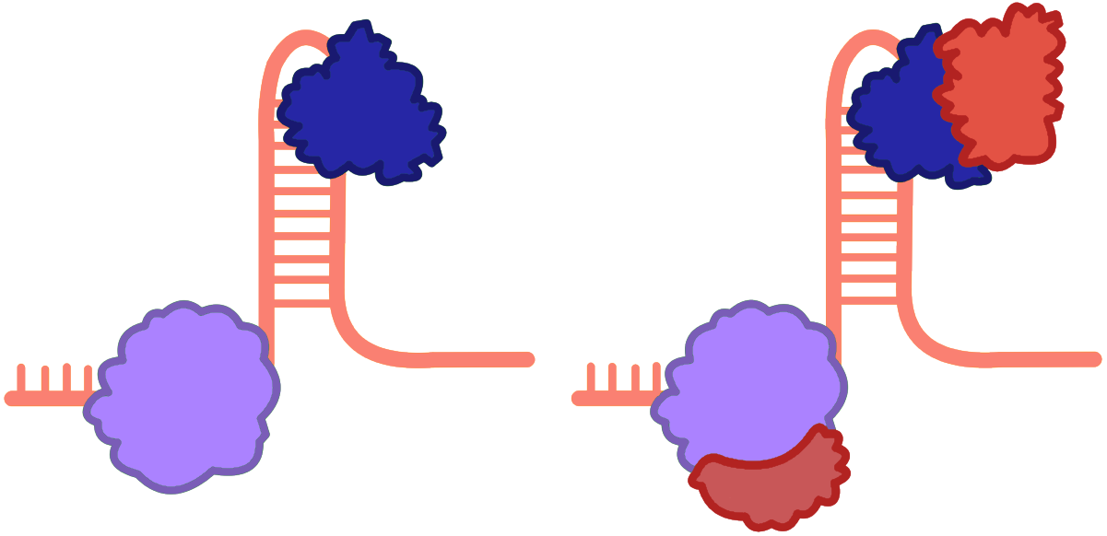
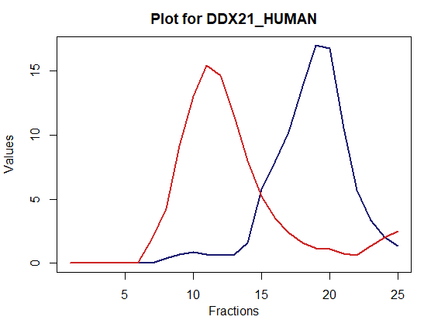
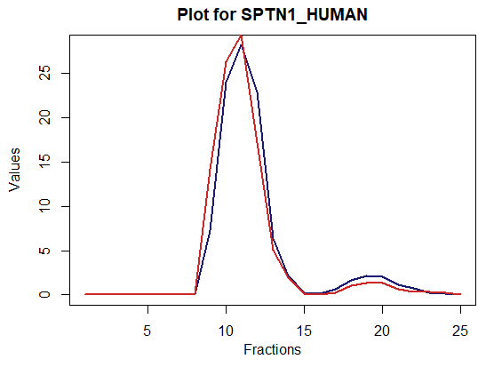
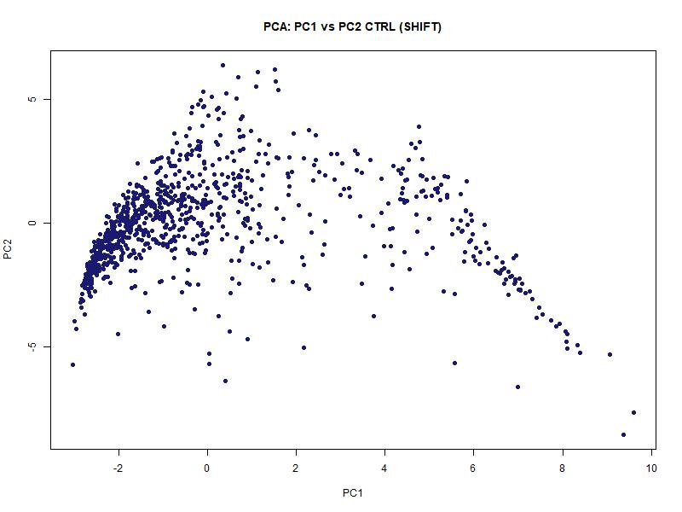
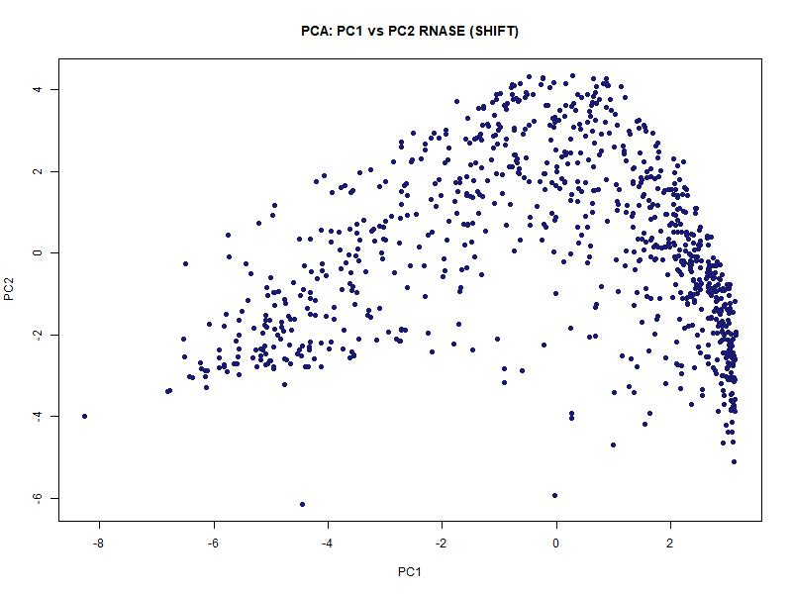
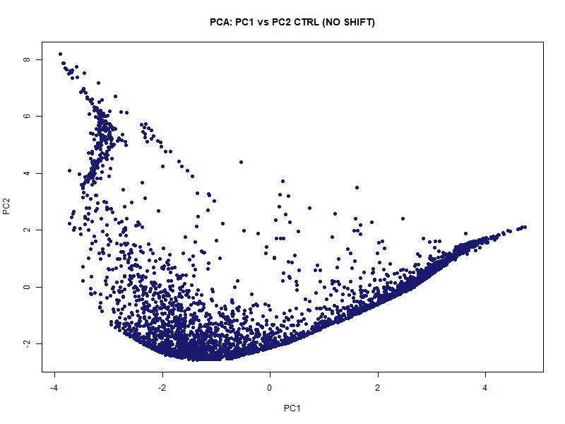
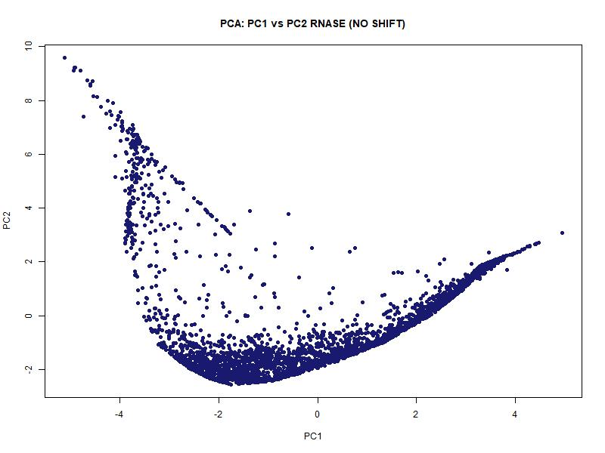
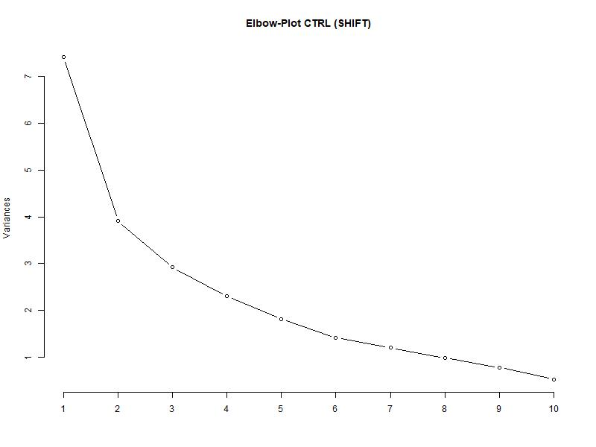
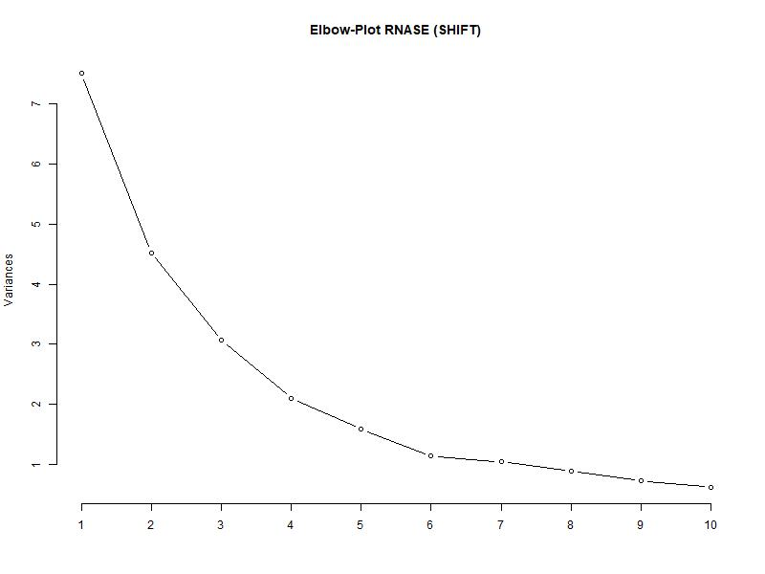
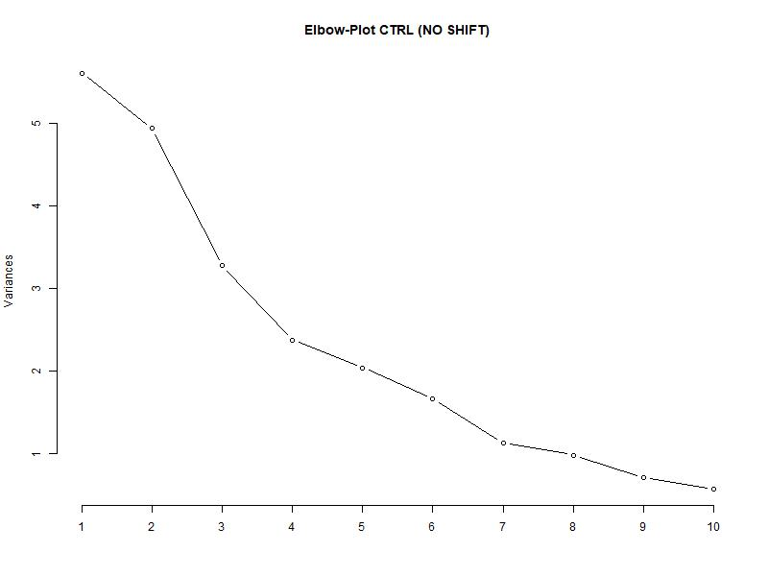
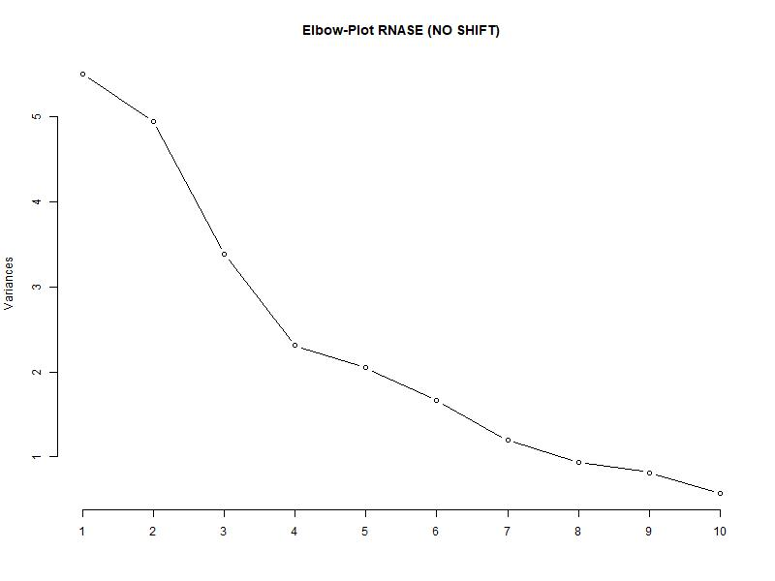
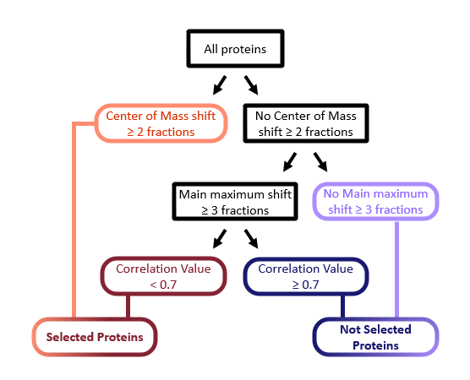
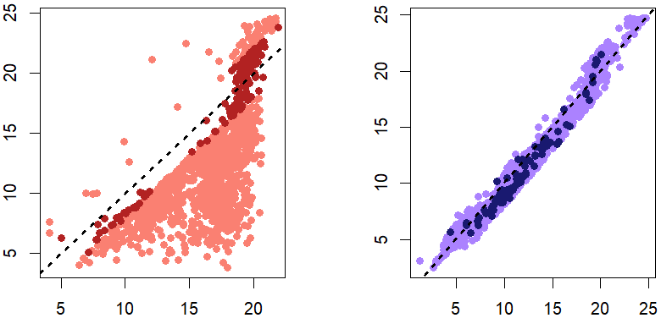
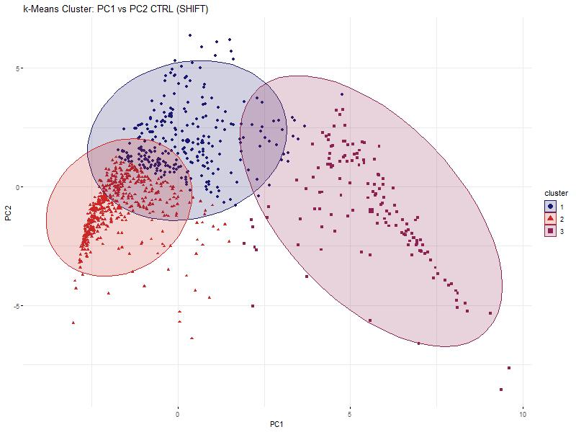
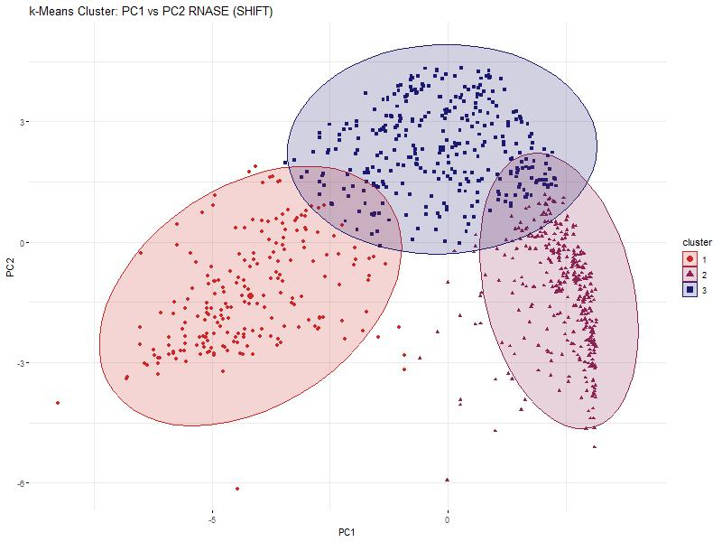
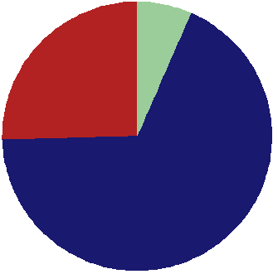
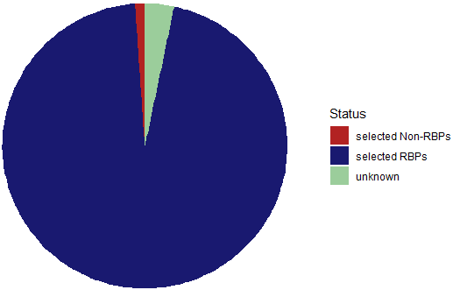
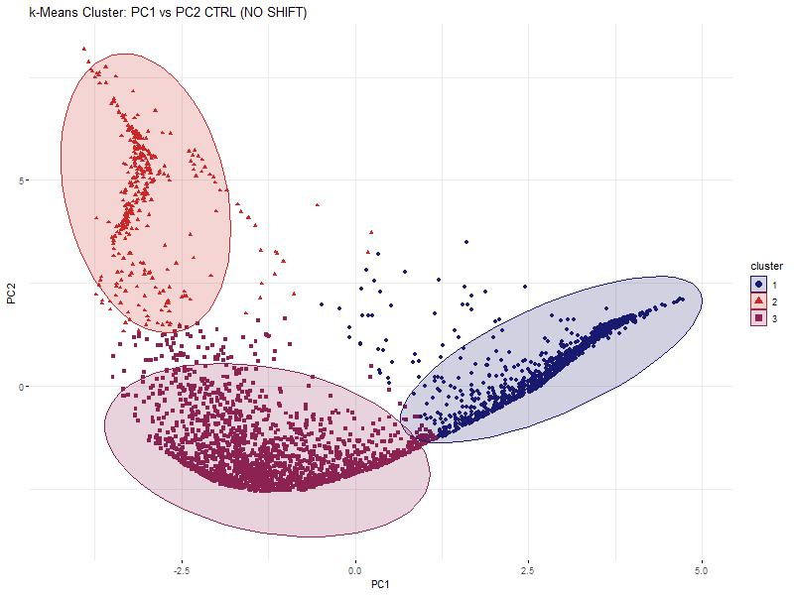
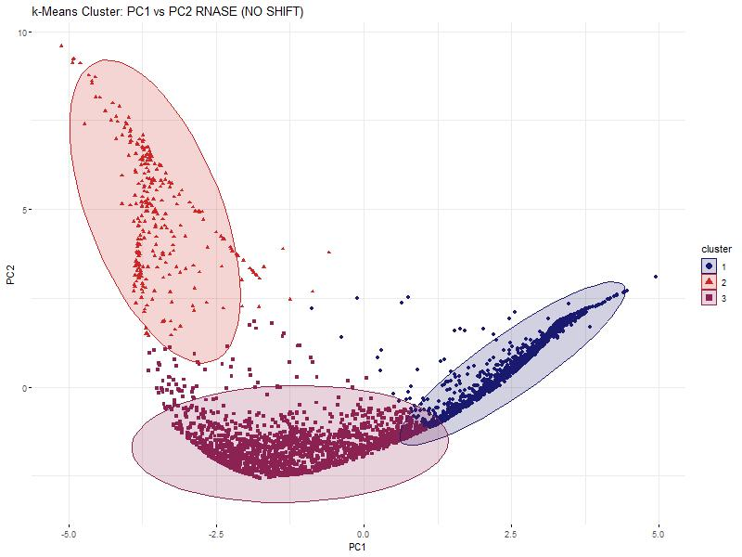

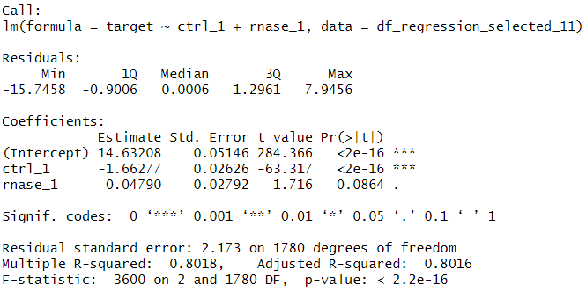
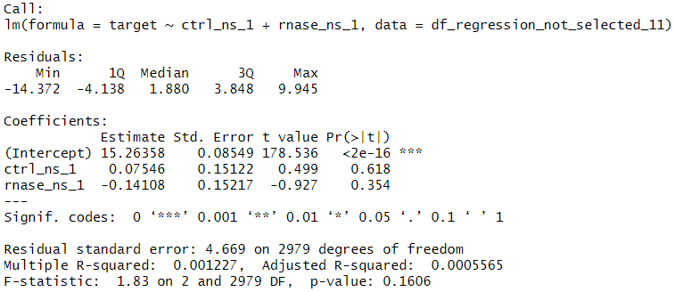

Hidden Alliances:
RNA-Dependent Protein Interactions
in Cancer Cells
Baureis, J., Ferdin, J., Nicklas, B., Wintel, L.
Data Analysis Project Molecular Biotechnology SS2025
1
https://media.discordapp.net/attachments/942220665635880990/1391120974107250830/image.png?ex=686abdde&is=68696c5e&hm=aba124b02f32de4a0951fec1e1f4ec30cc92823908418468efea0b60f3d38706&=&format=webp&quality=lossless
Identifying RNA-Dependent Proteins from Proteomic Data
What Makes RNA-Dependent Proteins Worth Investigating?
Key Regulators: RBPs control RNA metabolism & gene expression.
Disease Links: Misregulation is tied to cancer & neurodegeneration.
Functional Clues: New RBPs hint at RNA’s role in specific pathways.
Interaction Networks: Mapping RNA-protein complexes reveals regulatory logic.
Molecular Insights: Deepens our understanding of cell cycle and cellular behavior.
2A
B
What is RNA-dependency?
The proteins interactome depends on RNA
„We want to extract RNA-dependent proteins from proteomic screens”
Key Characteristics of Our Dataset
Our dataset was generated using the R-Deep approach
4765 proteins in 25 fractions, RNASE vs. CTRL
Fig. 2 Plot of protein in data set. The data has been cleaned and normalized beforehand.
A) The protein DDX21_HUMAN is plotted. It is part of the selected proteins and shows a clear shift between RNASE and CTRL. B) The protein SPTN1_HUMAN from the not selected proteins and no shift.
5A
B
2
Our Approach and Results
C
D
3
Fig. 5 Principle Component Analyses and Elbowplots of the selected and the non-selected proteins. RNASE and CTRL are plotted separately for comparison.
A) PCA of the selected proteins. The data points of the RNASE compared to the CTRL make up an overall similar shape, but a shift is visible in the density of the points. B) PCA of the non-selected proteins. The points of the RNASE and CTRL form mostly the same structure. C) Elbow-Plot of the selected proteins. The knick of the elbow is at 3. D) Elbow-Plot of the non-selected proteins. The knick of the elbow is between 3 and 4. To compare selected and non-selected proteins, we decided to use 3 cluster in the kmeans clustering.
4A
Comparison of COM values among selected proteins
B
Comparison of COM values among not selected proteins
COM values for rnase subset
COM values for rnase subset
Fig 1 Schematic Illustration of RNA-dependency
A proteins is considered if ist interactome is dependent
Fig. 3 Criteria used to classify proteins as RNA-dependent (selected) or non-RNA-dependent (not selected)
Selected proteins met one of the following conditions: – A center of mass (COM) shift of ≥ 2 fractions (color: orange) – No COM shift, but a main maximum shift of ≥ 3 fractions and a correlation value < 0.7 between control (CTRL) and RNase samples (RNASE) (color: red)
Not selected proteins met one of the following: – No COM shift ≥ 2 fractions and no main maximum shift ≥ 3 fractions (color: purple) – Or a main maximum shift with no COM shift, and a correlation value ≥ 0.7 between CTRL and RNASE (color: dark blue)
COM values for control subset
COM values for control subset
Fig 4 Scatter Plots showing altered locations for the center of mass (COM) values between control and rnase for the selected and not selected proteins
Each dot represents a protein. A) Scatter plot for the selected proteins. The COM values for the protein in the control distributions are on the x-axis, those for the rnase distributions are on the y-axis. The colors are the same as in Fig 3, and describe the substes of the selected proteins. B) Scatter plot for the not selected proteins. The COM values for the proteins in the control distributions are on the x-axis, those for the rnase distributions are on the y-axis. The colors are the same as in Fig 3 and describe the subsets of the not selected proteins.
3
4
Discussion
Our Achievements
6A
B
Fig. 6 kmeans clustering of the selected and not-selected proteins
A) Shows the 3 clusters of the CTRL of the selected proteins. B) Shows the 3 clusters of the RNASE of the selected proteins. A significant shift in form and location of the clusters is noticeable. C) Shows the 3 clusters of the CTRL of the not-selected proteins. D) Shows the 3 clusters of the RNASE of the not-selected proteins. No shift in form and location is noticeable.
We found 951 different RNA dependent proteins and 3814 proteins that are not RNA dependent
Our selection criteria seem to work well for detecting RNA dependent proteins and they can be continued to be used in the future
C
D
Fig. 7 Linear regression analyses between the selected proteins and the not-selected proteins each, with global maxima of the selected CTRL proteins as target variable
A) The left regression analysis for the selected proteins describes the target variable well, the right analysis of the not-selected proteins does not. This proves, that there is a difference between the selected and not-selected proteins, and therefore, that the selection criteria worked.
5
References
7A
Sternburg et al., Global Approaches in Studying RNA-Binding Protein Interaction Networks, 2020, Trends in Biochemical Sciences.pdf
Caudron-Herger et al., R-DeeP Proteome-wide and Quantitative Identification of RNA-Dependent Proteins by Density Gradient Ultracentrifugation, 2019, Molecular Cell.pdf
Caudron-Herger et al., Identification, quantification and bioinformatic analysis of RNA-dependent proteins by RNase treatment and density gradient ultracentrifugation using R-DeeP-2020-Nature Protocols_1.pdf
Corley et al., How RNA-Binding Proteins Interact with RNA Molecules and Mechanisms, 2020, Molecular Cell.pdf
Rajagopal et al., An atlas of RNA-dependent proteins in cell division reveals the riboregulation of mitotic protein-protein interactions. Nat. Commun. 16, 2325 (2025).pdf

